Slide 1

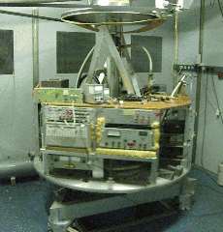
Turbulence in Superfluid ⁴He in the T = 0 Limit
Relaxation, Turbulence and Non-Equilibrium Dynamics of Matter Fields
Heidelberg, 22 June 2012
Andrei Golov
Paul Walmsley, Sasha Levchenko, Joe Vinen, Henry Hall,
Peter Tompsett, Dmitry Zmeev, Fatemeh Pakpour, Matt Fear
Helium systems: order and topological defects
Vortex tangles in superfluid ⁴He in the T=0 limit
Manchester experimental techniques
Freely decaying quantum turbulence

Slide 2
Condensed helium atoms (low mass, weak attraction) = “Quantum Fluids and Solids”
(substantial zero-point motion and particle exchange at T = 0)
Superfluid ⁴He – simple o. p., only one type of top. defects: quantized vortices, coherent mass flow
Superfluid ³He – multi-component o. p. (Cooper pairs with orbital and spin angular momentum), various top. defects, coherent mass and spin flow
Solid helium – broken translational invariance, anisotropic o. p., various top. defects, quantum dynamics, optimistic proposals of coherent mass flow

Slide 3
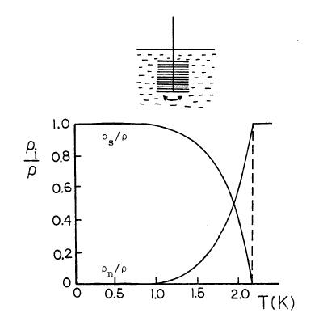

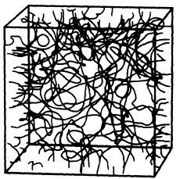
Superfluid ⁴He
= |Ψ|e^{iφ}
v_{s} = h/m ∇φ
K.W. Schwarz, PRB 1988
Superfluid component: inviscid & irrotational.
Vorticity is concentrated along lines of Ψ=0 circulation round these lines is preserved.
At T = 0, location of vortex lines are
the only degrees of freedom.

Slide 4
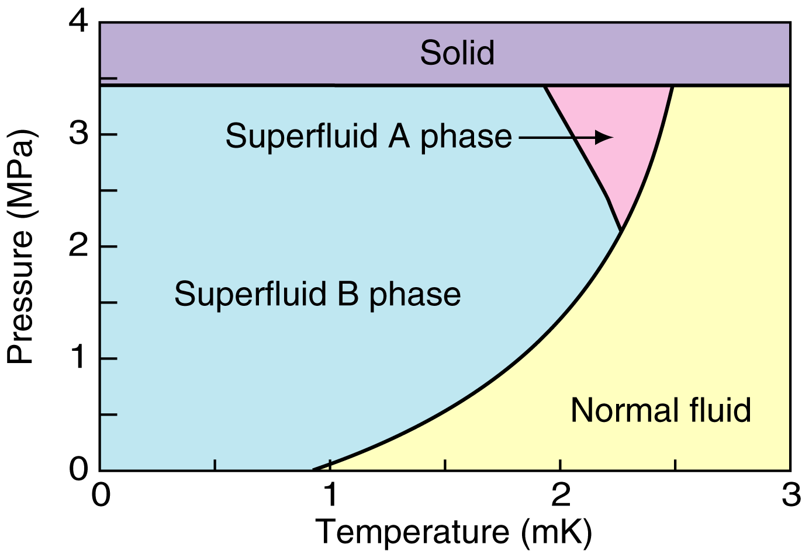
Superfluid ³He-A
l
d
p-wave, spin triplet Cooper pairs
Two anisotropy axes:
l - direction of orbital momentum
d - spin quantization axis (s.d)=0
l
Order parameter: 6 d.o.f.:
A_{μj}=∆(T)(m_{j}+in_{j})d_{µ}
n
m
SO(3) x SO(3) x U(1)
In ³He-A, viscous normal component is
present at all accessible temperatures
³He-A in slab:
Z₂ x Z₂ x U(1)

Slide 5
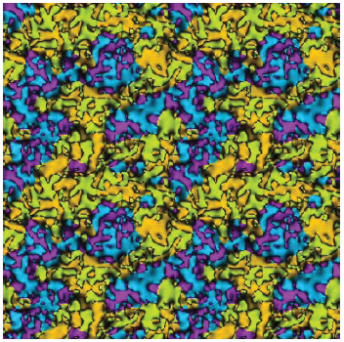
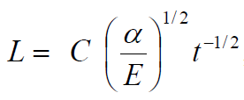
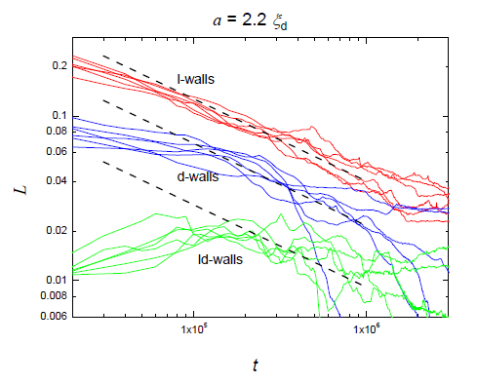
Free decay:
Domain walls in 2d superfluid ³He-A
A.I.Golov, P.M.Walmsley, R.Schanen, D.E.Zmeev

Slide 6
Solid helium (quantum crystal)
Can be hcp (layered) or
bcc (~ isotropic)
Point defects (vacancies, impurities, dislocation kinks) become quasiparticles
Dislocations are expected to behave non-classically
“Supersolid” hype
Theoretical predictions of coherent mass transport
resonant frequency
dissipation
Torsional oscillations
Zmeev, Brazhnikov, Golov 2012,
after E. Kim et al., PRL (2008)

Slide 7
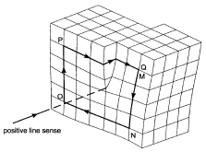

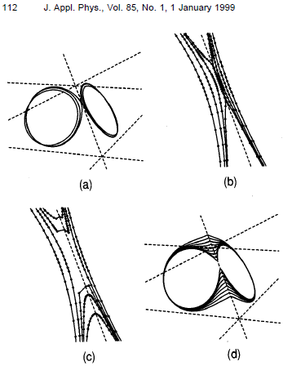
Dislocations in crystals:
K. W. Schwarz. Simulation of dislocations on the mesoscopic ...
First ever linear topological defects proposed (1934)
Similar to quantized vortices but can split and merge
Different dynamics in cubic (bcc) and layered (hcp) crystals

Slide 8
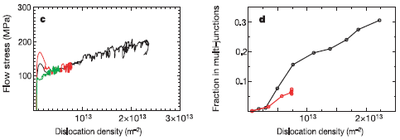
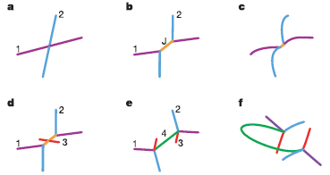
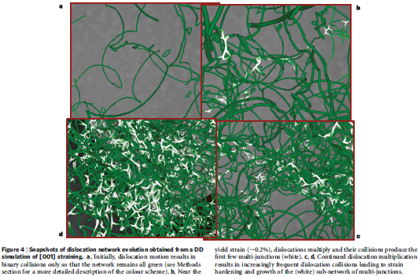
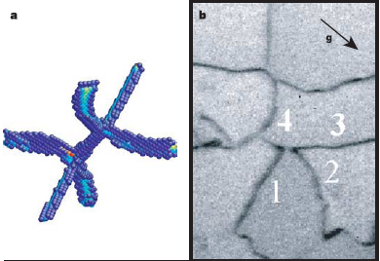
Dislocations in bcc crystals:
Dislocation multi-junctions and strain hardening
V. V. Bulatov et al., Nature 440, 1174 (2006)

Slide 9
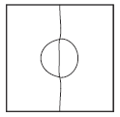
Tangles of quantized vortices in ⁴He at low temperature
Microscopic dynamics of each vortex filament is well-understood since Helmholtz (~1860).
It is the consequences of their interactions and especially reconnections – that are non-trivial.
The following concepts require attention:
          classical vs. quantum energy,
          vortex reconnections.
From simulations by Tsubota, Araki, Nemirovskii (2000)
T = 1.6 K
T = 0
An important observable – length of vortex line per unit volume (vortex density) L .
However, without specifying correlations in polarization of lines, this is insufficient.
mean inter-vortex distance
d
Classical
l = L^{-1/2}
Quantum
dissipation
k
45 mm
vortex bundles, etc.
0.03 – 3 mm
Kelvin waves
λ ~ 3 nm

Slide 10
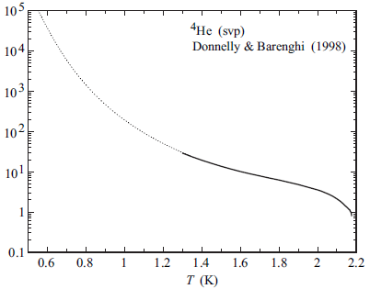
What is the T = 0 limit?
α⁻¹
T = 1.6 K
T = 0
mean inter-vortex distance
d
Classical
l = L^{-1/2}
Quantum
dissipation
k
45 mm
0.03 – 3 mm
λ ~ 3 nm
vortex bundles, etc.
Kelvin waves

Slide 11
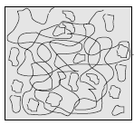
Types of vortex tangles
Uncorrelated (Vinen) tangle of vortex loops (E_{c} << E_{q} ) :
Free decay: L(t) = B ν⁻¹t ⁻¹ ,
where B = ln(l/a₀)/4π =1.2,
if dE/dt = - ν(κL)²
E_{k}
k
l ⁻¹
Correlated tangles (e.g. eddies of various size as in HIT of Kolmogorov type).
When E_{c} >> E_{q} , free decay L(t) = (3C)^{3/2}κ⁻¹k₁⁻¹ ν^{-1/2}t^{-3/2}
where C ≈ 1.5 and k₁ ≈ 2π/d,
if size of energy-containing eddy is constant in time,
its energy lifetime dE_{c} /dt = d(u²/2)/dt = - Cu³d⁻¹ ,
dE/dt = - ν(κL)² .
E_{k}
k
d ⁻¹
l ⁻¹

Slide 12
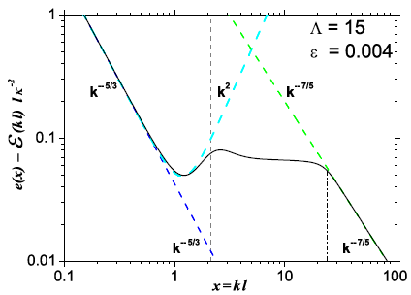
Quasi-classical turbulence at T=0
Kozik and Svistunov, 2007-2008
(reconnections, fractalization,
build-up of vorticity at mesoscales ~ l)
L’vov, Nazarenko, Rudenko, 2007-2008
(bottleneck, pile-up of vorticity at mesosclaes ~ l)
I.e. at T = 0, it is expected to have excess L at scales ~ l.

Slide 13
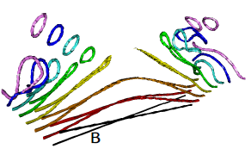

Which processes constitute the Quantum Cascade?
length scale
crossover to QT
reconnections of vortex bundles
reconnections between neighbors in the bundle
self – reconnections
(vortex ring generation)
Kursa, Bajer, Lipniacki, (2011)
purely non-linear cascade of Kelvin waves
(no reconnections)
phonon radiation
(Kozik & Svistunov, 2007)

Slide 14
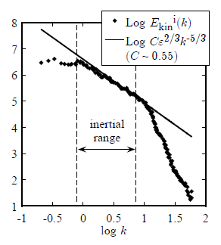
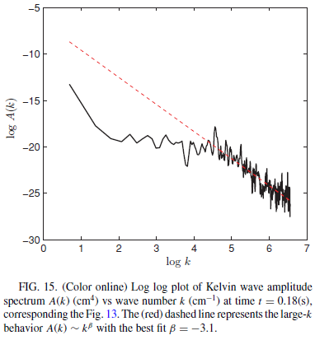
Simulations (T=0)
Classical cascade: k^{-5/3} spectrum
Gross-Pitaevskii:
Nore, Abid and Brachet (1997)
Kobayashi and Tsubota (2005)
Machida et al. (2008)
Filament model (Biot-Savart):
Araki, Tsubota, Nemirovskii (2002)
Kelvin wave cascade: k ^{-ε} , ε ~ 3
Vinen, Tsubota et al.,
Kozik & Svistunov,
L’vov, Nazarenko et al., Hanninen
Baggaley & Barenghi (2011):
As yet, no satisfactory simulations of both cascades at once

Slide 15
Experiment: Goals & Challenges
- Study one-component superfluid ⁴He at T = 0 (T < 0.3 K , ³He concentration < 10⁻¹⁰)
- Force turbulence at either large or small length scales
- Aim at homogeneous turbulence
- Investigate steady state and free decay
- Measure: vortex line length L, dissipation rate
- Try to observe evidences of non-classical behaviour (at quantum length scales): reconnections of vortices and bundles, Kelvin waves and vortex rings, dissipative cut-off, quantum cascade

Slide 16
Techniques: Trapped negative ions
When inside helium at T < 0.7 K, electrons (in bubbles of R ~ 19 Å) nucleate vortex rings
Charged vortex rings can be manipulated and detected.
Charged vortex rings of suitable radius used as detectors of L:
Force on a charged vortex tangle can be used to engage liquid into motion
Transport of ions through the tangle can be used to investigate microscopic processes

Slide 17
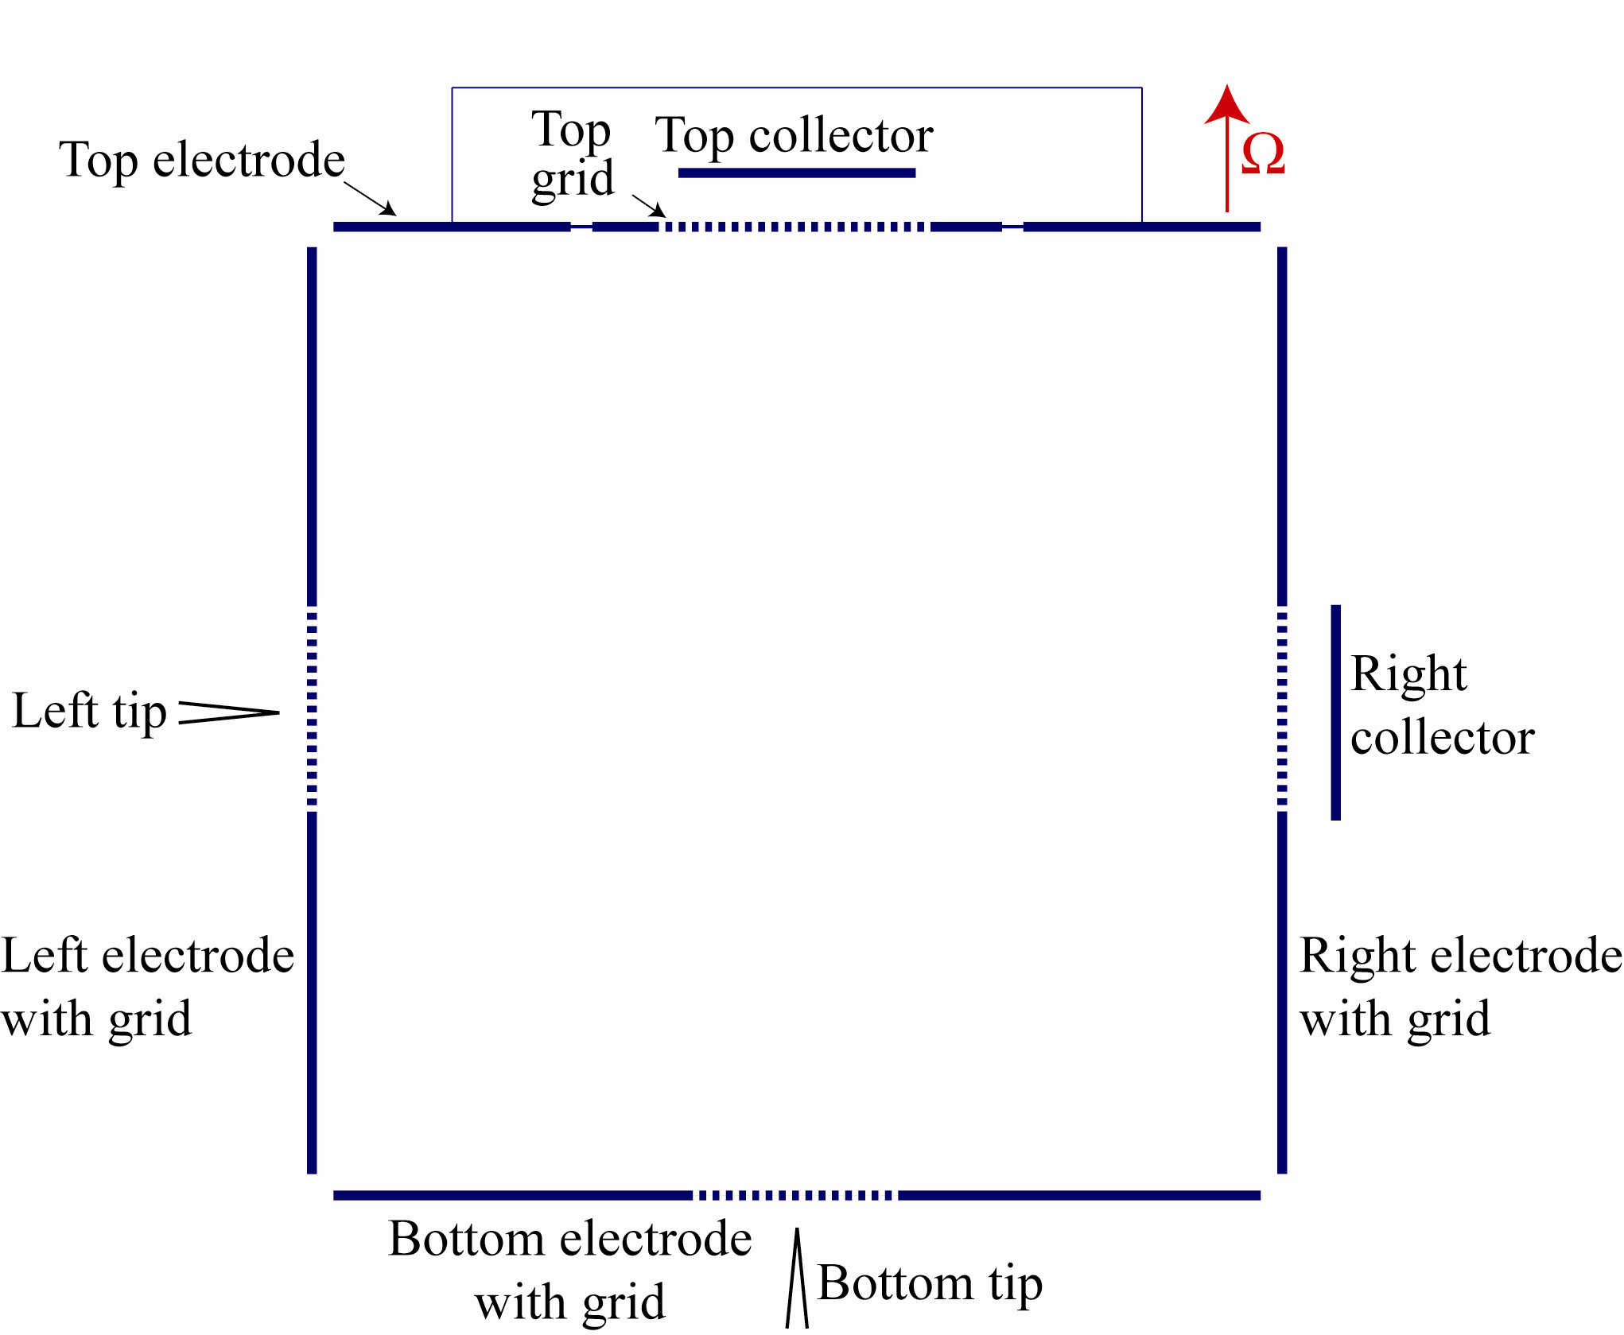
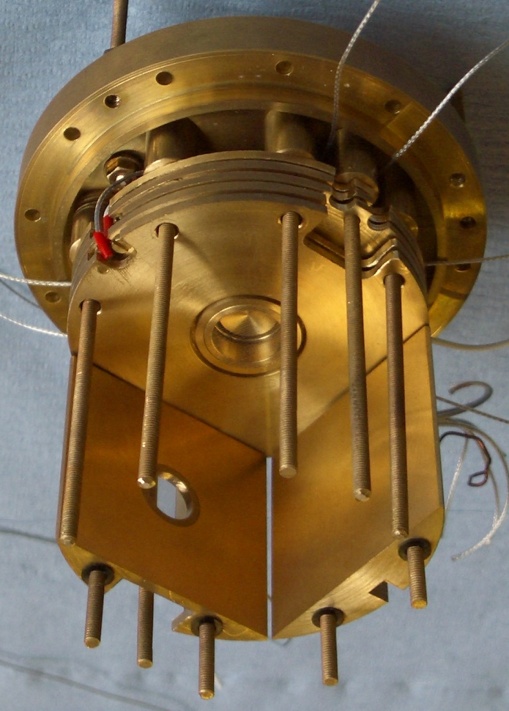
Experimental Cell
The experiment is a cube with sides of length 4.5 cm containing pure ⁴He (P = 0.1 bar).
4.5 cm
We can create an array of vortices by rotating the cryostat
We can inject rings from the side
We can also inject rings from the bottom

Slide 18
Free decay of ultra-quantum turbulence (little large-scale flow)
Τ = 0.15 Κ
ν = 0.1 κ
L(t) = 1.2 ν⁻¹t ⁻¹
Simulations of non-structured tangles:
Tsubota, Araki, Nemirovskii (2000): ν ~ 0.06 k (frequent reconnections)
Leadbeater, Samuels, Barenghi, Adams (2003): ν ~ 0.001 k (no reconnections)

Slide 19
Means of generating large-scale flow
1. Change of angular velocity of container
(e.g. impulsive spin-down from Ω to rest
or AC modulation of Ω)
2. Dragging liquid by current of ions
(injected impulse ~ I×∆t)
I×∆t
Ω

Slide 20
Free decay of quasi-classical turbulence (dominant large-scale flow)
t ^{-3/2}
L(t) = (3C)^{3/2}κ⁻¹k₁⁻¹ ν^{-1/2}t ^{-3/2}
where C ≈ 1.5 and k₁ ≈ 2π/d.

Slide 21
Free decay of quasi-classical turbulence (E_{c} > E_{q} )
E_{k}
k
d ⁻¹
l ⁻¹

Slide 22
Summary
1. Liquid and solid ³He and ⁴He are quantum systems with a choice of complexity of order parameter.
2. We can study dynamics of tangles/networks of interacting line defects (and domain walls).
3. Quantum Turbulence (vortex tangle) in superfluid ⁴He in the T = 0 limit is well-suited for both experiment and theory.
4. There are two energy cascades: classical and quantum.
5. Depending on forcing (spectrum), tangles have either classical or non-classical dynamics.

